Slide 1
FYP 2019 - 2020
PREDICTING ONLINE TRANSACTION FRAUDS USING MACHINE LEARNING
GROUP MEMBERS: GUIDE:
Magilan S - 16BLC1005 Dr. Suganthi K
Ashish Kumar Sahu - 16BLC1077

Slide 2
MOTIVATION
Online fraud is a wide-ranging term for theft and fraud committed using or involving a payment methods, such as a credit card or debit card or online transaction, as a fraudulent source of funds in a transaction.
Billions of dollars of loss are caused every year by fraudulent credit card transactions.
The advent of capability to collect, store and process huge amount plays a major role in detecting fraud.

Slide 3
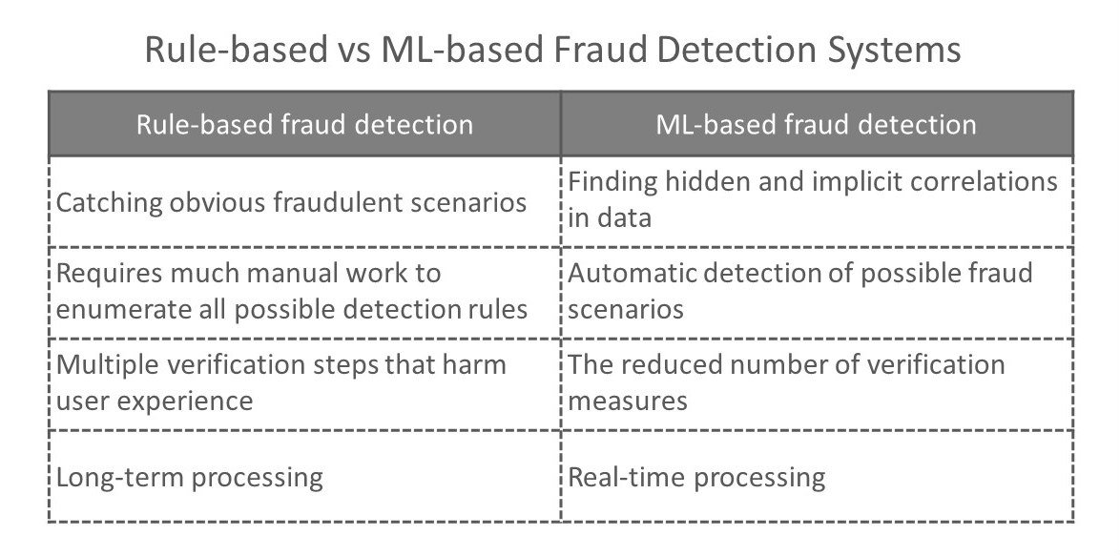

Slide 4
RULE BASED FRAUD DETECTION
False positives:
  Using lots of rules tends to result in a high number of false positives - meaning you’re likely to block a lot of genuine customers.
Fixed outcomes:
  The thresholds for fraud behaviour can change over time - if your prices change, the average order value can go up, meaning that orders over $500 become the norm, and so rules can become invalid.

Slide 5
OBJECTIVE
Objective of this project is to come up with a system to detect the fraudulent online transaction while the transaction is taking place.
And build an application to increase security and to prevent the frauds.
And come up with a statistical model to deal with the imbalanced classifier.
Analysis of different statistical and machine learning models.

Slide 6
LITERATURE SURVEY
AUTHORS | TOPIC | SOURCE | INFERENCE
Sam Maes, Karl Tuyls, Bram Vanschoenwinkel | Credit card fraud detection using Bayesian and neural networks | CiteSeer 2002 | This paper implements the model, which gives us the probability of the fraudulent transaction. Limitation: Learning time can go several hours in ANN
Yufeng Kou , Chang-Tien Lu , S. Sirwongwattana , Yo-Ping Huang | Survey of fraud detection techniques | IEEE 2004 | In this paper, fraud detection in three areas, credit card fraud detection and computer intrusion detection is discussed. Limitation: It is difficult to implement because of lack of proper extensive data set.
Yusuf Sahin, Serol Bulkan, Ekrem Duman | A cost-sensitive decision tree approach for fraud detection | Elsevier 2013 | Each fraud is assumed to have a different misclassification cost. This approach can prioritize frauds according to their misclassification costs.

Slide 7
AUTHORS | TOPIC | SOURCE | INFERENCE
Jon T.S.Quah, M. Sriganesh | Real-time credit card fraud detection using computational intelligence | Elsevier 2007 | This paper focuses on real-time fraud detection and presents a new and innovative approach in understanding spending patterns to decipher potential fraud cases. Limitation: The imbalanced dataset causes the problem in the learning of the patterns
 | Credit Card Fraud Detection | Kaggle | Given the class imbalance ratio, the accuracy have to measured using the Area Under the Precision-Recall Curve (AUPRC).
Carcillo Fabrizio, Le Borgne Yann-Aël, Caelen Olivier, Bontempi Gianluca | Streaming active learning strategies for real-life credit card fraud detection: assessment and visualization, International Journal of Data Science and Analytics | Springer 2018 | This paper investigates the impact of active learning strategies on the fraud detection accuracy in credit cards. Limitation: The data are strongly imbalanced and prone to non-stationarity.

Slide 8
AUTHORS | TOPIC | SOURCE | INFERENCE
Dal Pozzolo, Andrea | Adaptive Machine learning for credit card fraud detection. | ULB MLG PhD thesis 2016 | This thesis focuses on issues such as: i) why and how under-sampling is useful in the presence of class imbalance, ii) how to deal with unbalanced and evolving data, iii) how to assess performances in a way which is relevant for detection and iv) how to use feedbacks provided by investigators on the fraud alerts generated.

Slide 9
EXPECTED OUTPUT
Create different models that can properly classify transactions as either legit or fraudulent.
Compare and analyze various machine learning models to find the best suited model.
Build an application that improves the security and authenticity of the transaction

Slide 10
SOFTWARE USED
Machine learning/ Model building:
R
Python
Web development:
Flask (FOR API)
HTML (web Page)

Slide 11
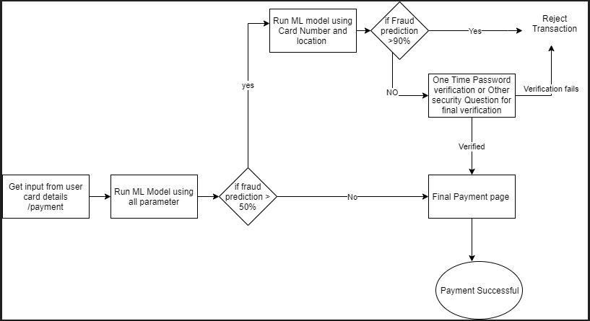
APPLICATION FLOWCHART

Slide 12
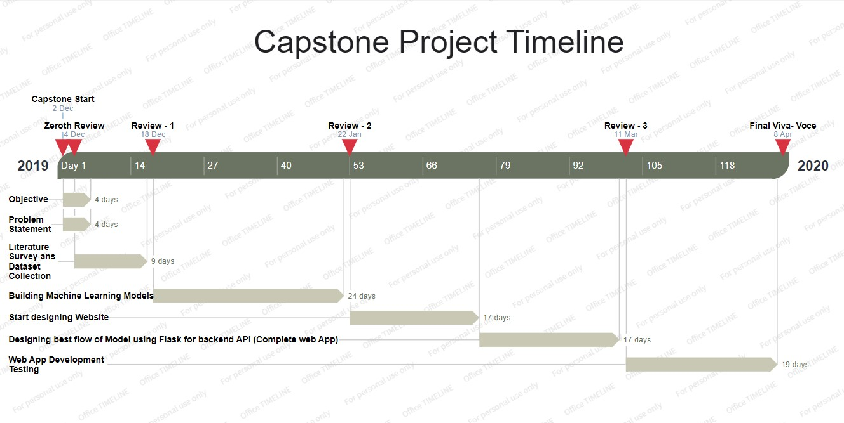
TIMELINE

Slide 13
REFERENCES
[1] Sam Maes, Karl Tuyls and Bram Vanschoenwinkel, “Credit card fraud detection using Bayesian and neural networks”, Source: CiteSeer 2002, Available online: https://www.researchgate.net/publication/2524707_Credit_Card_Fraud_Detection_Using_Bayesian_and_Neural_Networks.
[2] Carcillo Fabrizio, Le Borgne Yann-Aël, Caelen Olivier and Bontempi Gianluca “Streaming active learning strategies for real-life credit card fraud detection: assessment and visualization”, International Journal of Data Science and Analytics, Springer 2018.
[3] Dal Pozzolo Andrea, ”0Adaptive Machine learning for credit card fraud detection”, ULB MLG PhD thesis 2016.
[4] Rafael Pierre, “Detecting Financial Fraud Using Machine Learning”, 2018, Available online: https://towardsdatascience.com/detecting-financial-fraud-using-machine-learning-three-ways-of-winning-the-war-against-imbalanced-a03f8815cce9

Slide 14
[5] Machine learning group ULB, “Credit Card Fraud Detection: Anonymized credit card transactions labeled as fraudulent or genuine”, 2017, Source: Kaggle, Available online: https://www.kaggle.com/mlg-ulb/creditcardfraud
[6] Kevin McCarty, “Fraud Detection using Python”, Python Articles 2018, Available online: https://www.accelebrate.com/blog/fraud-detection-using-python
[7] Navoneel Chakrabarty, “Application of Synthetic Minority Over-sampling Technique (SMOTE) for Imbalanced Datasets”, 2019, Available online: https://medium.com/towards-artificial-intelligence.
[8] “Oversampling and undersampling in data analysis”, Source: Wikipaedia, Available Online: https://en.wikipedia.org/wiki/Oversampling_and_undersampling_in_dataanalysis

